Slide 1



Development of ventilation based strategies to reduce ammonia & odour
emissions from pig fattening houses:
an integrated approach
Raphael Tabase, Jan Vierendeels, Eva Brusselman, Bart Sonck,
Peter Demeyer
COST LivAge Training School on modelling emissions
2019 March 16th
Notes:
Objectives: Techniques and Management Tools for Pollutant Emission Reduction in Flemish Piggery

Slide 2
Why?
EU regulations + odour abatement
Existing ‘expensive’ emission reduction systems (50-70%)
Need for additional low cost (management) systems (10-20%)
Hypothesis: lower ventilation rates ≈ lower emissions
Lower velocities near emitting surfaces
Prohibit displacement of pit headspace air
Integrated approach for detailed information
Measuring & modelling
Test platform & full scale experiments

Slide 3
Ventilation settings
V_{max} = 70 m³h⁻¹pig⁻¹
ΔT_{c} = 5 °C
V_{min} = 14 m³h⁻¹pig⁻¹

Slide 4
Indoor Climate Model
Promising ventilation strategies
CFD Model
Temperature &
Velocity distribution
Test Platform
Confirm ventilation strategies
NH₃ Emission Model
Predict NH₃ emission
Full Scale Experiments
Innovative Ventilation Regimes/Strategies

Slide 5
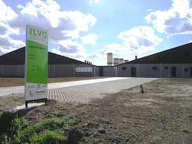
Test object
ILVO-UGent
Pig Campus

Slide 6
Indoor Climate Model
Promising ventilation strategies
CFD Model
Temperature &
Velocity distribution
Test Platform
Confirm ventilation strategies
NH₃ Emission Model
Predict NH₃ emission
Full Scale Experiment
Innovative Ventilation regimes/Strategies

Slide 7
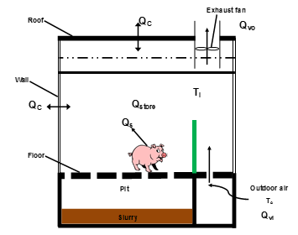
Indoor Climate Model
Time-dependent mass and energy balance equations
Validation with ILVO-UGent farm data
Reference ventilation regime & 9 others
Output MatLab
Ventilation rate
Indoor temperature & RH
CO₂
Strategies with higher CO₂ concentrations (winter) removed
Strategies with lower average ventilation rates selected

Slide 8
Indoor Climate Model
Promising ventilation strategies
CFD Model
Temperature &
Velocity distribution
Test Platform
Confirm ventilation strategies
NH₃ Emission Model
Predict NH₃ emission
Full Scale Experiment
Innovative Ventilation regimes/Strategies

Slide 9
CFD Model
Spatial distribution of indoor T and air velocity near emitting surfaces
Assess different building design parameters on indoor air distribution
Compartment
32-48 pigs at 60 kg
Boundary conditions
From indoor climate model
Slatted floor as porous medium

Slide 10
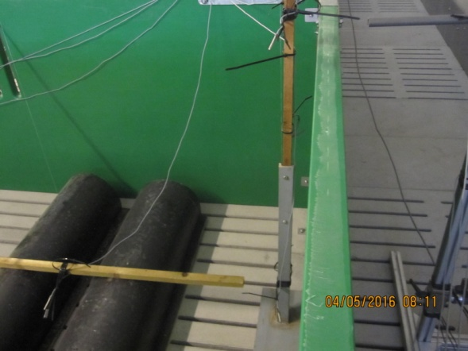
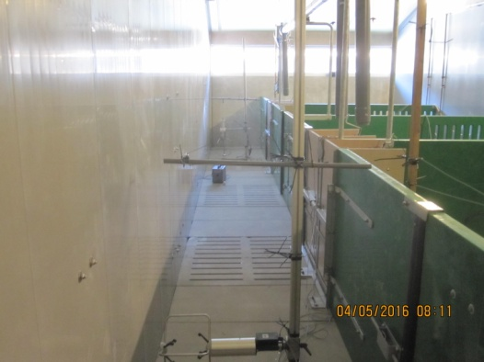
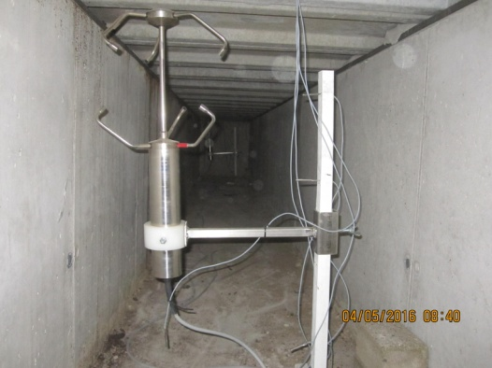
Validation with mock-up pigs

Slide 11
Velocity Distribution
Pen 7
Pen 3
Pen 1
Walking alley
Notes:
Below is plane in the middle of the ground channel
Winter conditions

Slide 12
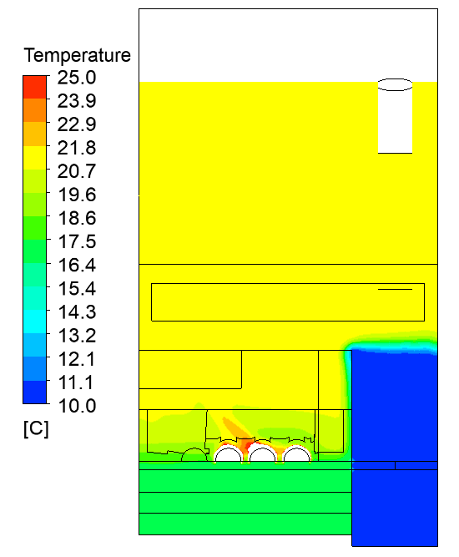
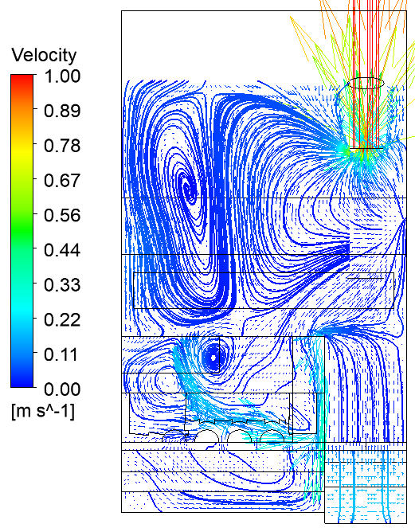
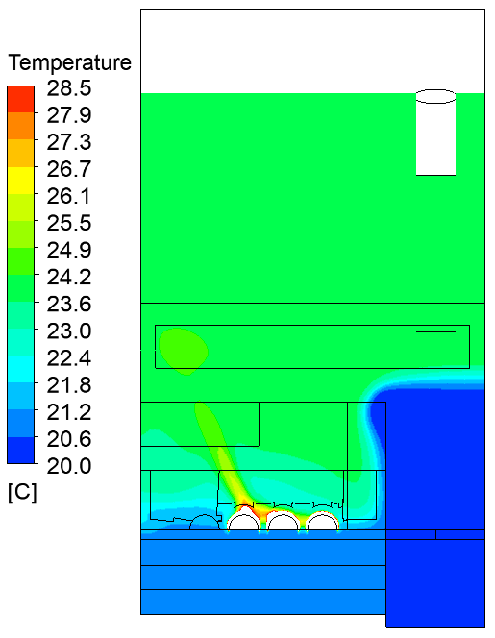
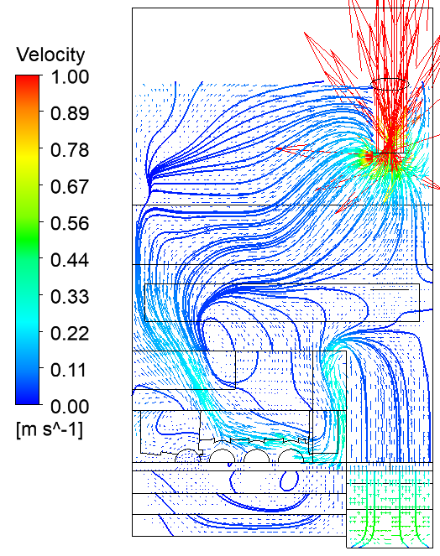
T_GC = 10 °C and VR = 714 m³ h⁻¹
T_GC = 20 °C and VR = 1937 m³ h⁻¹
Notes:
Top graph showes air going into the pit (low GC T and VR)

Slide 13
Inlet close to slurry pit and airflow by displacement

Slide 14
Indoor Climate Model
Promising ventilation strategies
CFD Model
Temperature &
Velocity distribution
Test Platform
Confirm ventilation strategies
NH₃ Emission Model
Predict NH₃ emission
Full Scale Experiment
Innovative Ventilation regimes/Strategies

Slide 15
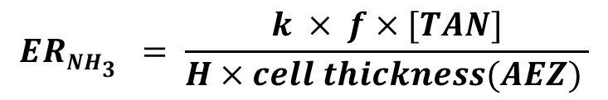


CFD Model: NH₃ Emission UDF for air volume source
$$ERNH3_{}=k ({{[NH}_{3}]}_{gas}−{{[NH}_{3}]}_{atmostphere})$$
$$ERNH3_{}= \frac{k × f×[TAN]}{H×cell thickness(AEZ) }$$
UDF cell zone: extract velocity & T as mass transfer coefficient input parameters
Mass transfer Coefficient
$$k=50.1×v^{0.8}×T^{−1.4}$$
(Haslam et al., 1924)
Notes:
Air volume source

Slide 16
Validation with real pigs
Temperature
NH₃ (detection tube)
NH₃ & CO₂ measured at exhaust (FTIR)
48 pigs at ~90 kg

Slide 17
Results
Parameter | Experiment | CFD
Room temperature (°C) | 23.2 ± 0.1 | 23.3
Exhaust CO₂ (ppm) | 2138 ± 169 | 1981
Exhaust NH₃ (ppm) | 16.1 ± 0.9 | 16.2
CO₂ emission rate (g h⁻¹) | 107.9 ± 9.5 | 98
NH₃ emission rate (g h⁻¹) | 0.40 ± 0.03 | 0.40
Notes:
Room T is measured at 1,4m above slatted floor pen 3

Slide 18
NH₃ Distribution
Pen 7
Pen 3
Pen 1
Walking alley

Slide 19
Indoor Climate Model
Promising ventilation strategies
CFD Model
Temperature &
Velocity distribution
Test Platform
Confirm ventilation strategies
NH₃ Emission Model
Predict NH₃ emission
Full Scale Experiment
Innovative Ventilation regimes/Strategies

Slide 20
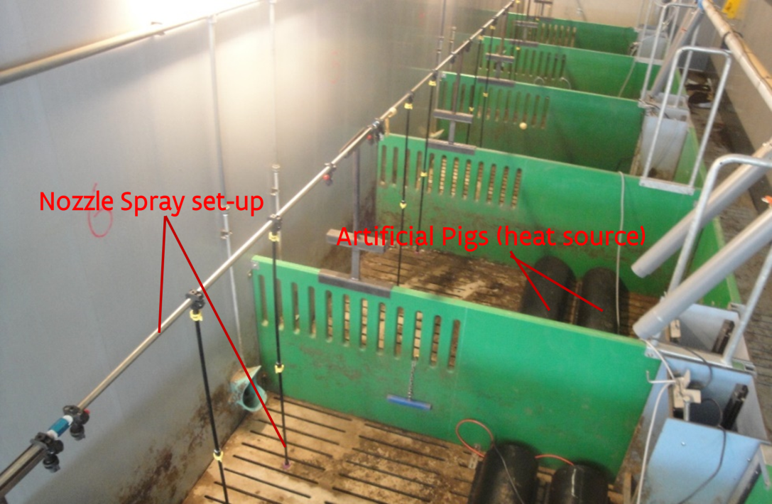
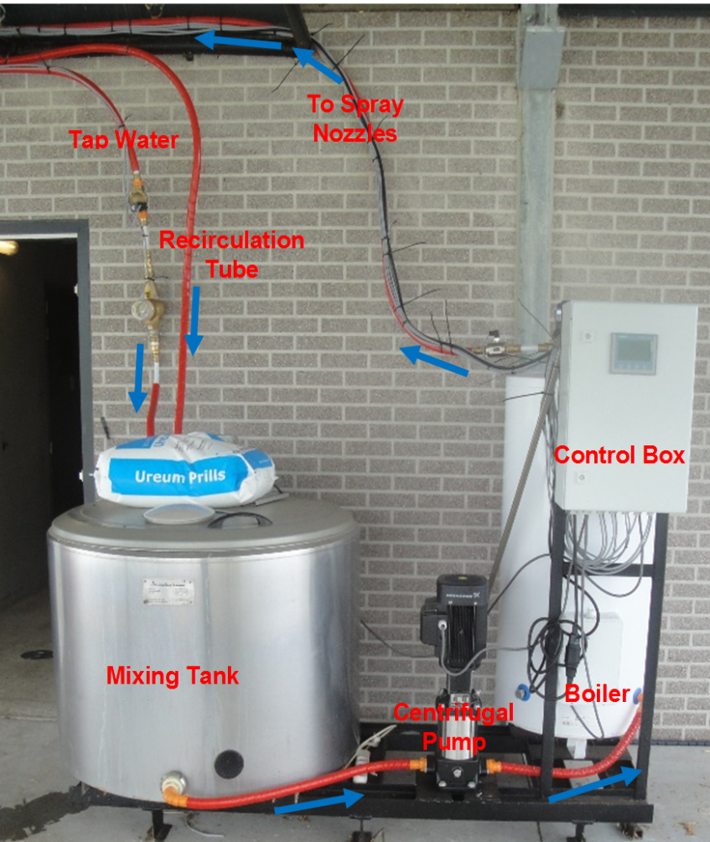
Test platform
2.3 kW from mock-up pigs
Urea solution: 0.2 mol L⁻¹
Temperature: 37 °C
Spray frequency: 3 u; 12 L; 0.99 L min⁻¹

Slide 21
Set-point temperature | V_{min} (m³h⁻¹pig⁻¹) | V_{max} (m³h⁻¹pig⁻¹)
T_{set} = 23 °C (Control) | 14 | 70
T_{set} = 25 °C (T1) | 14 | 70
T_{set} = 21 °C (T4) | 14 | 70
Notes:
Increase setpoint less emissions

Slide 22
Indoor Climate Model
Promising ventilation strategies
CFD Model
Temperature &
Velocity distribution
Test Platform
Confirm ventilation strategies
NH₃ Emission Model
Predict NH₃ emission
Full Scale Experiment
Innovative Ventilation regimes/Strategies

Slide 23
Full-scale Experiment
Control setpoint +2°C
4 ventilation (C, T1, T2, T3) regimes in fully-slatted compartments
3 fattening rounds (August 2016 – November 2017)
Duplicate treatments per round (8 compartments)
NH₃, CO₂, CH₄, N₂O (FTIR)
Odour concentrations
Monitored pig performance

Slide 24
Indoor Climate Model
Promising ventilation strategies
CFD Model
Temperature &
Velocity distribution
Test Platform
Confirm ventilation strategies
NH₃ Emission Model
Predict NH₃ emission
Full Scale Experiment
Innovative Ventilation regimes/Strategies

Slide 25
Full-scale Experiment
Variable | T1 | Control
T_{out} (°C) | 13.3 ± 5.7 | 13.3 ± 5.7
T_{GC} (°C) | 15.1 ± 3.8 | 15.1 ± 3.8
T_{i} (°C) | 25.1 ± 1.1 (1.1) | 24.0 ± 1.2
VR (m³ h⁻¹ pig⁻¹) | 26.5 ± 10.3 (-26%) | 35.8 ± 11.9
NH₃ Conc. (ppm) | 16.6 ± 4.1 (19%) | 13.9 ± 5.0
Odour Conc. (OU_{E} m⁻³) | 1640 ± 481 (12%) | 1470 ± 633
NH₃ ER (kg pig⁻¹ yr⁻¹) | 2.26 ± 0.70 (-11%) | 2.53 ± 0.87
Odour ER (OU_{E} s⁻¹ pig⁻¹) | 11.3 ± 4.5 (-23%) | 14.7 ± 8.8

Slide 26
Full-scale Experiment

Slide 27


Thank you
Institute for Agricultural
and Fisheries Research
Burg. Van Gansberghelaan 115 box 1
9820 Merelbeke – Belgium
T + 32 (0)9 272 28 00
F +32 (0)9 272 28 01
t&v@ilvo.vlaanderen.be
www.ilvo.vlaanderen.be

